Slide 1
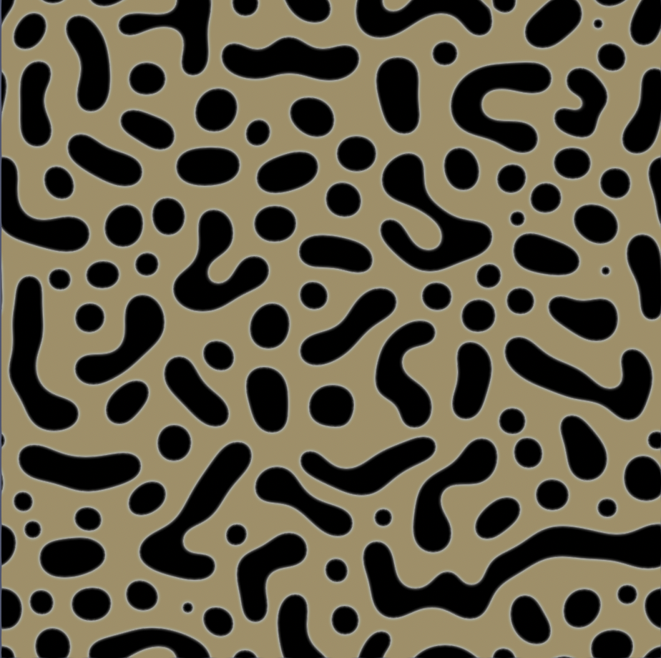


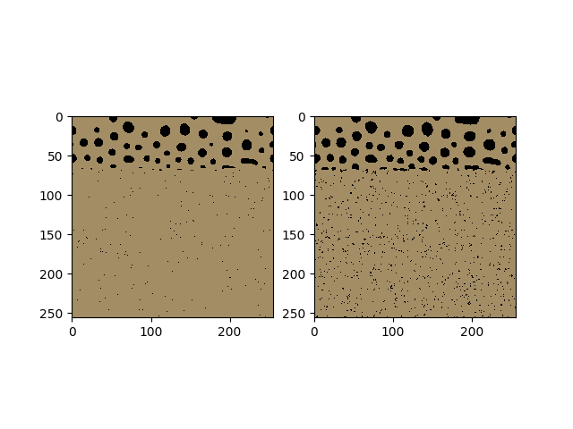
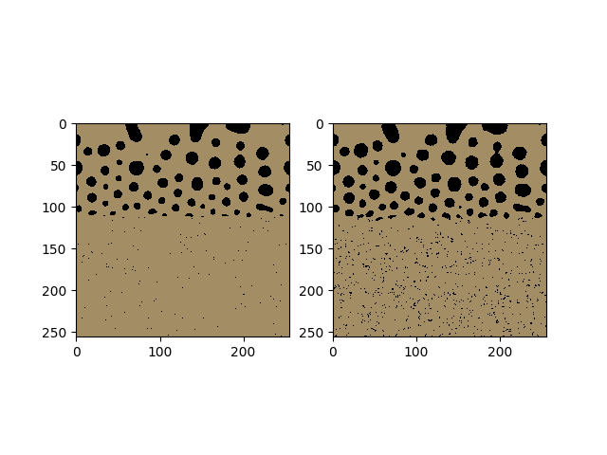
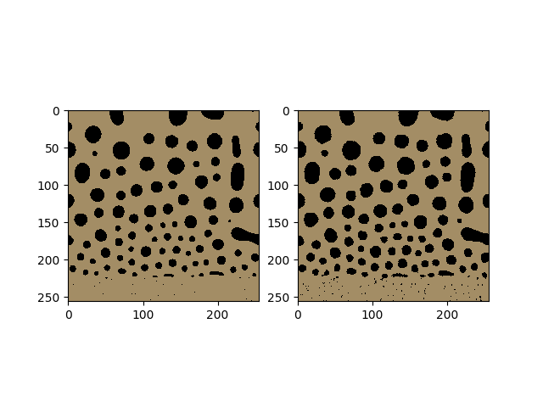



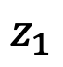
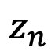
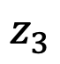
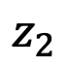
Microstructure reconstruction
Microstructure datasets
Latent dimension
$$z_{1}$$
$$z_{2}$$
$$z_{3}$$
$$z_{n}$$
Microstructure characterization
Metrics: Reconstruction capability, data compression
Notes:
Wanted to start by asking the question <TITLE>
Broad approach: Identify property of interest, identify which microstructures would help achieve that, and work backwards to design processing conditions that can achieve that desired microstructure
Example: If we want to design smart window coatings that (heat cool), we are looking for a material with temp dependent IR properties. One such material is Vox, which shows a temp-induced MIT that not only alters its conductivity but also its IR properties. Our efforts would then go into designing Vox films with MITs that makes them usable at a desired temp range, say by optimizing film thickness, composition etc.
Example: If we want to design solar cells high energy conversion efficiencies: looking for materials with bandgap properties which depends on material composition. Optimizing composition, we have found that GaAs and perovskite thin film solar cells allow conversion efficiencies much higher than Si based cells
Example: gears with high surface roughness, XXXX
The common thread across these applications is that <BOX> | <Composition, crystal structure, higher level microstructure

Slide 2
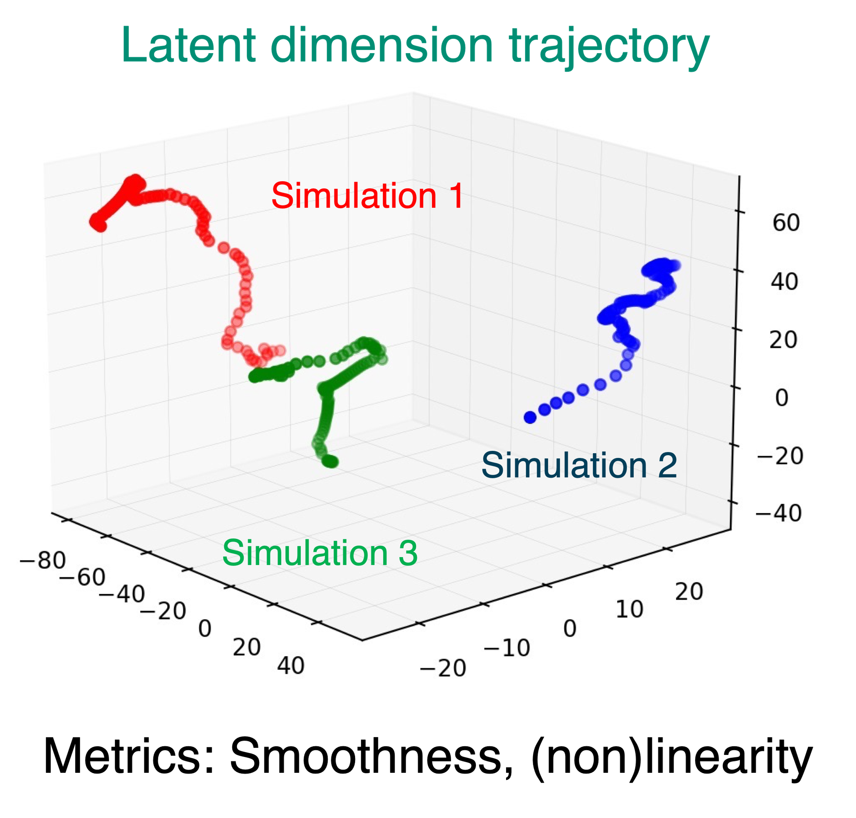
Dimensionality reduction
Microstructure trajectories
Latent dimension trajectories
Notes:
Wanted to start by asking the question <TITLE>
Broad approach: Identify property of interest, identify which microstructures would help achieve that, and work backwards to design processing conditions that can achieve that desired microstructure
Example: If we want to design smart window coatings that (heat cool), we are looking for a material with temp dependent IR properties. One such material is Vox, which shows a temp-induced MIT that not only alters its conductivity but also its IR properties. Our efforts would then go into designing Vox films with MITs that makes them usable at a desired temp range, say by optimizing film thickness, composition etc.
Example: If we want to design solar cells high energy conversion efficiencies: looking for materials with bandgap properties which depends on material composition. Optimizing composition, we have found that GaAs and perovskite thin film solar cells allow conversion efficiencies much higher than Si based cells
Example: gears with high surface roughness, XXXX
The common thread across these applications is that <BOX> | <Composition, crystal structure, higher level microstructure

Slide 3
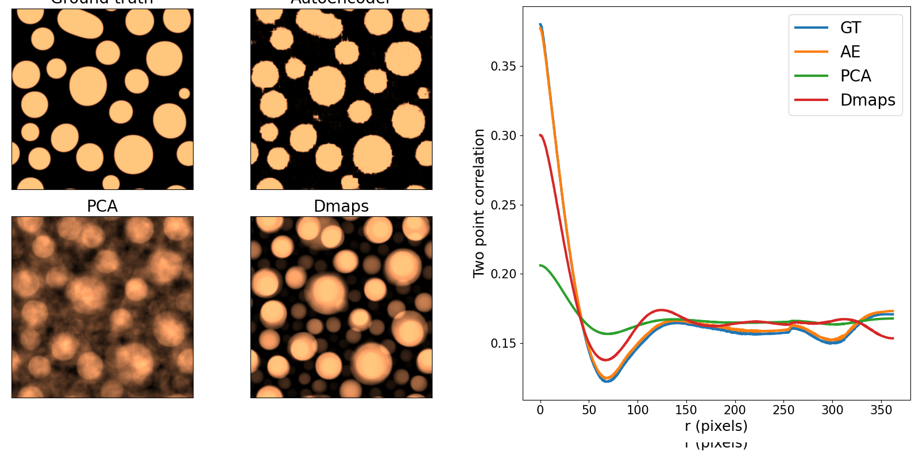
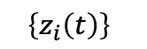
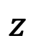
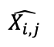

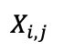
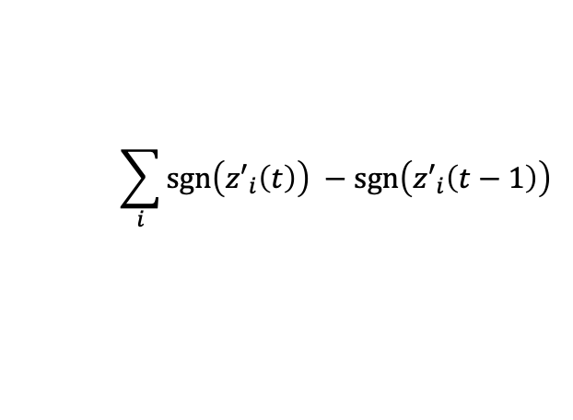
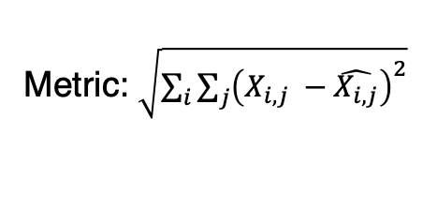
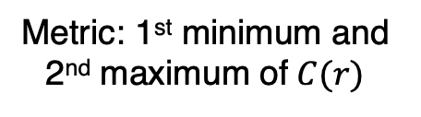
Methods
Metrics
Metric:
Global reconstruction
Local reconstruction
Smoothness
Principal Component Analysis
$$\left\{z_{i}\left(t\right)\right\}$$
$$z$$
Autoencoders
$$X_{i,j}$$
$$\hat{X_{i,j}}$$
Metric:
Diffusion Maps
Metric: $\sqrt{\sum_{i}{\sum_{j}{{\left(X_{i,j} −\hat{X_{i,j}}\right)}^{2}}}}$
Metric: 1st minimum and 2nd maximum of $C(r)$
$$\sum_{i}{\operatorname{sgn}\left({z′}_{i}\left(t\right)\right) −\operatorname{sgn}\left({z′}_{i}\left(t−1\right)\right)}$$
$$\cos^{−1}\left(\overline{z′\left(t\right)} .\overline{z′\left(t−1\right)}\right)$$
Notes:
Wanted to start by asking the question <TITLE>
Broad approach: Identify property of interest, identify which microstructures would help achieve that, and work backwards to design processing conditions that can achieve that desired microstructure
Example: If we want to design smart window coatings that (heat cool), we are looking for a material with temp dependent IR properties. One such material is Vox, which shows a temp-induced MIT that not only alters its conductivity but also its IR properties. Our efforts would then go into designing Vox films with MITs that makes them usable at a desired temp range, say by optimizing film thickness, composition etc.
Example: If we want to design solar cells high energy conversion efficiencies: looking for materials with bandgap properties which depends on material composition. Optimizing composition, we have found that GaAs and perovskite thin film solar cells allow conversion efficiencies much higher than Si based cells
Example: gears with high surface roughness, XXXX
The common thread across these applications is that <BOX> | <Composition, crystal structure, higher level microstructure

Slide 4
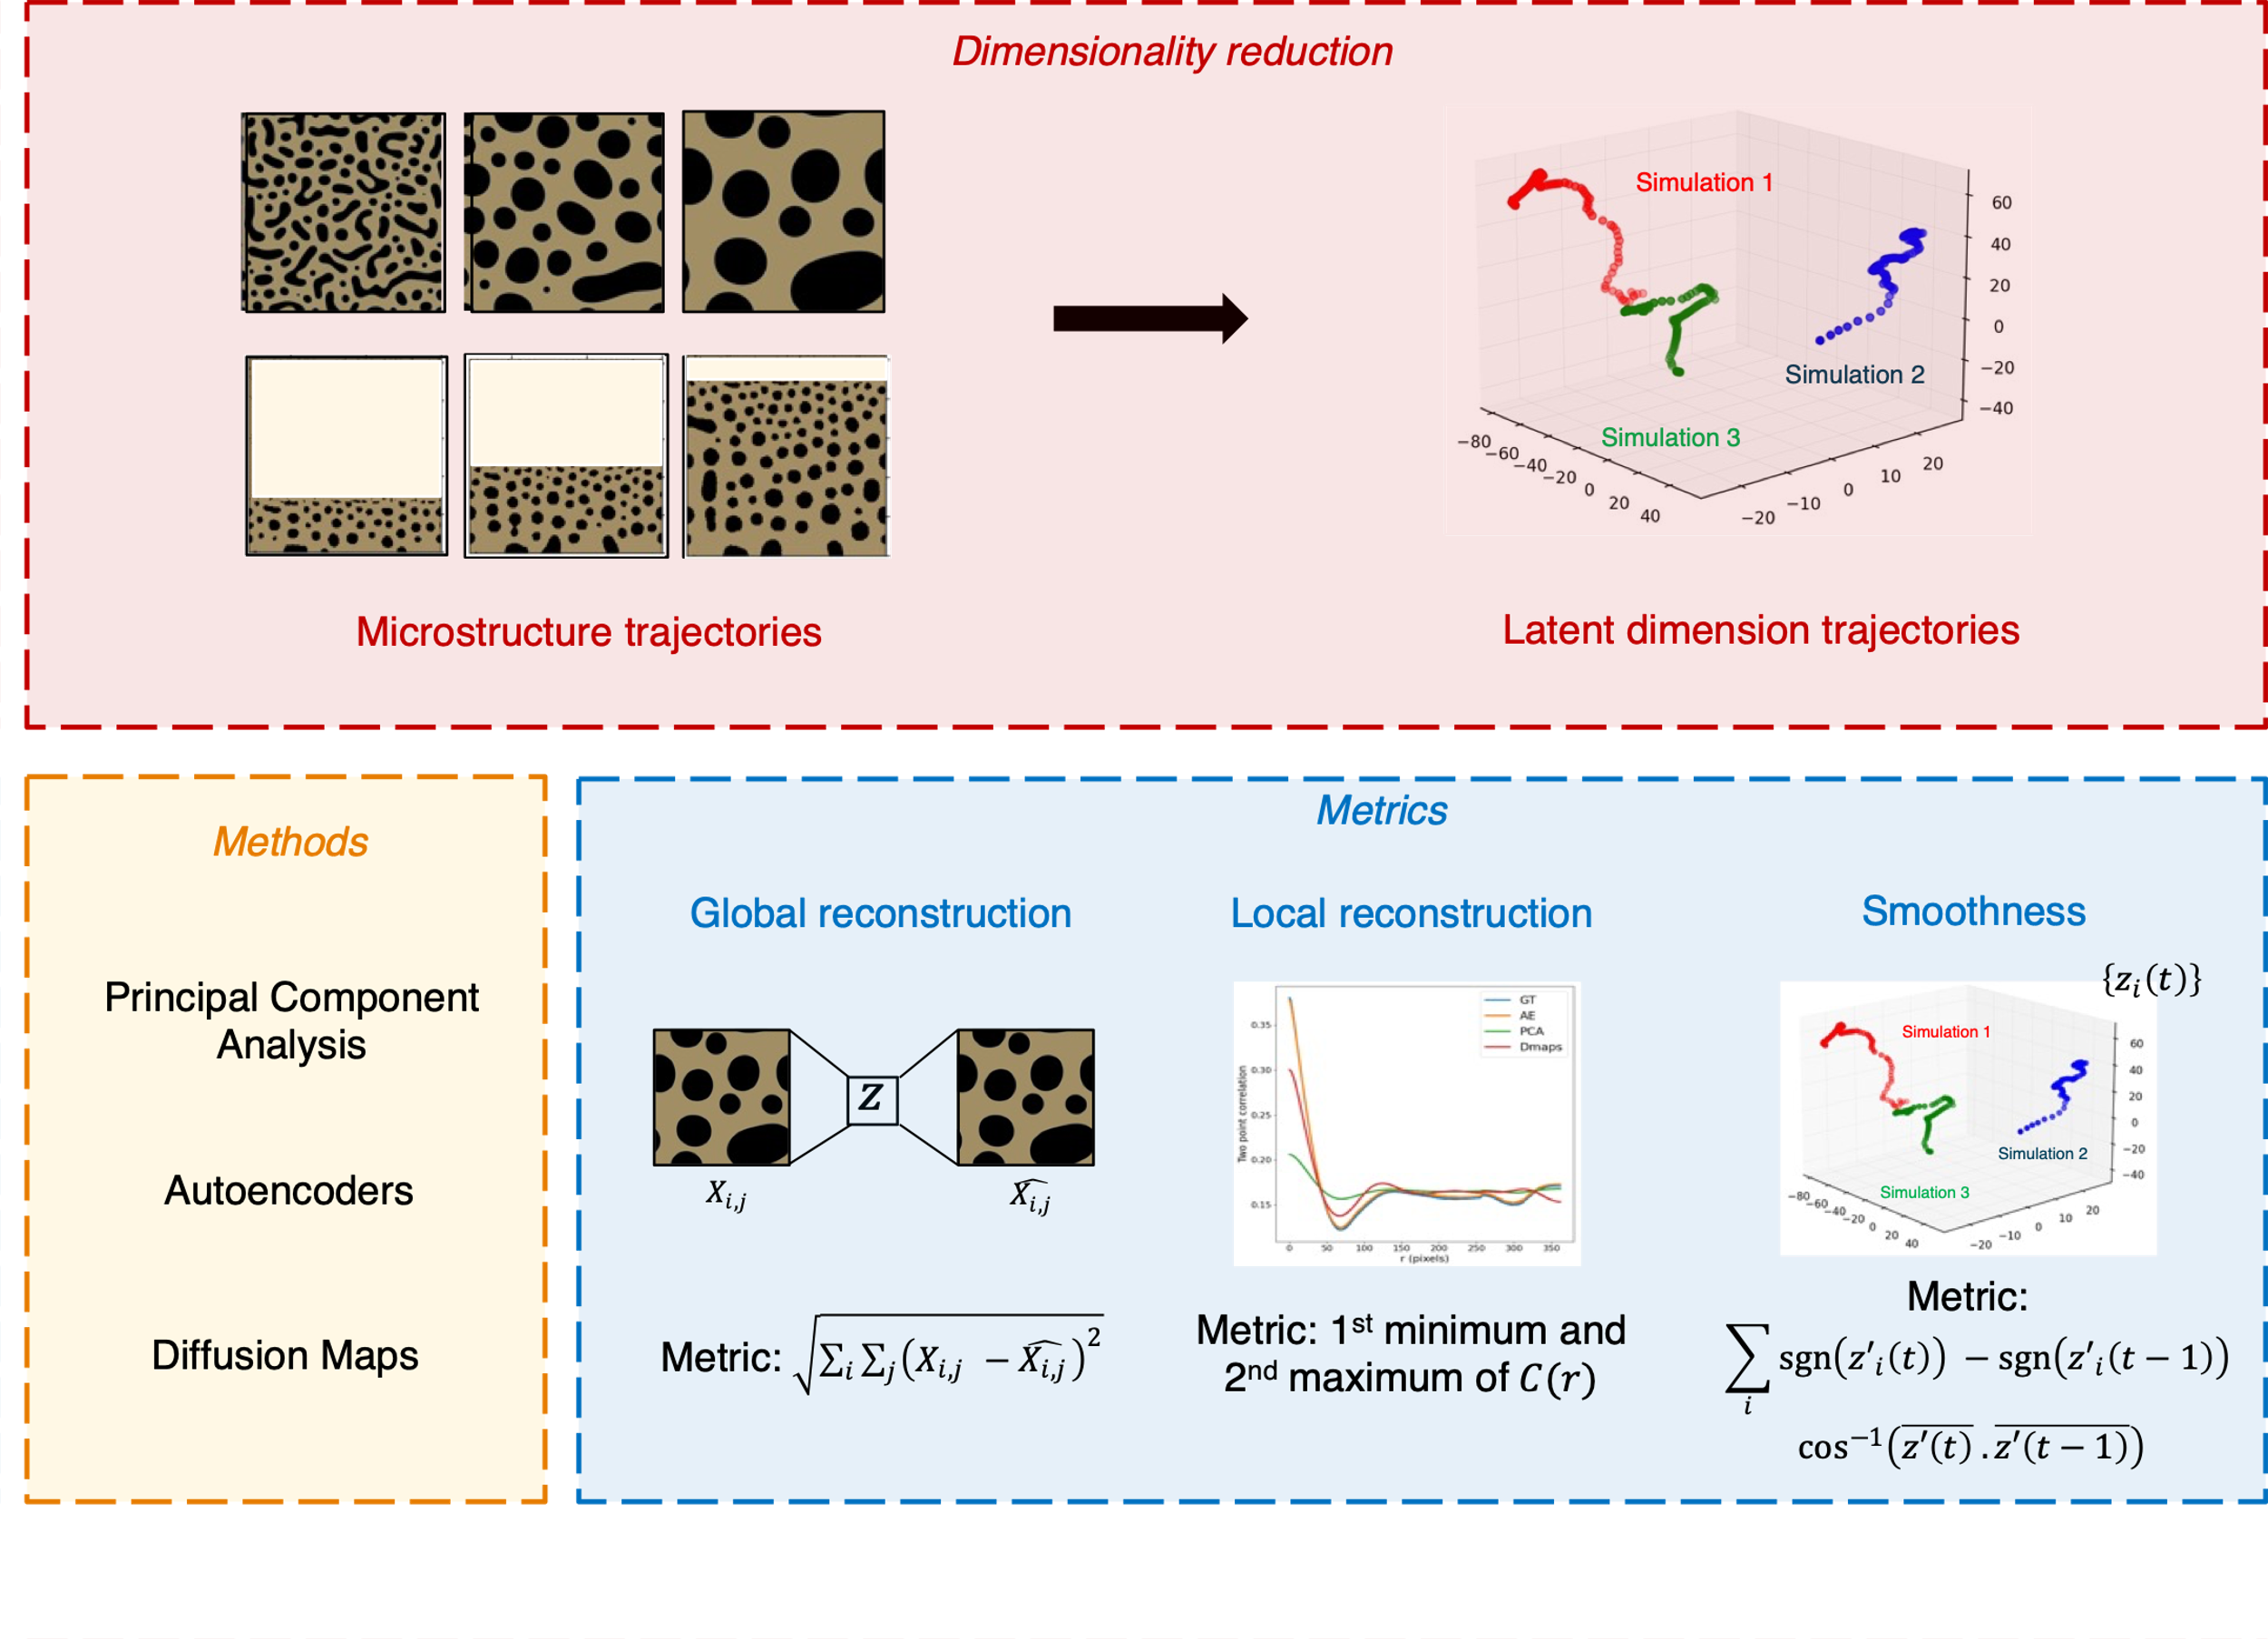
Notes:
Wanted to start by asking the question <TITLE>
Broad approach: Identify property of interest, identify which microstructures would help achieve that, and work backwards to design processing conditions that can achieve that desired microstructure
Example: If we want to design smart window coatings that (heat cool), we are looking for a material with temp dependent IR properties. One such material is Vox, which shows a temp-induced MIT that not only alters its conductivity but also its IR properties. Our efforts would then go into designing Vox films with MITs that makes them usable at a desired temp range, say by optimizing film thickness, composition etc.
Example: If we want to design solar cells high energy conversion efficiencies: looking for materials with bandgap properties which depends on material composition. Optimizing composition, we have found that GaAs and perovskite thin film solar cells allow conversion efficiencies much higher than Si based cells
Example: gears with high surface roughness, XXXX
The common thread across these applications is that <BOX> | <Composition, crystal structure, higher level microstructure

Slide 5
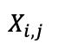
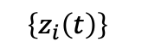
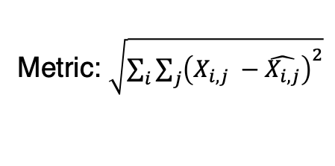

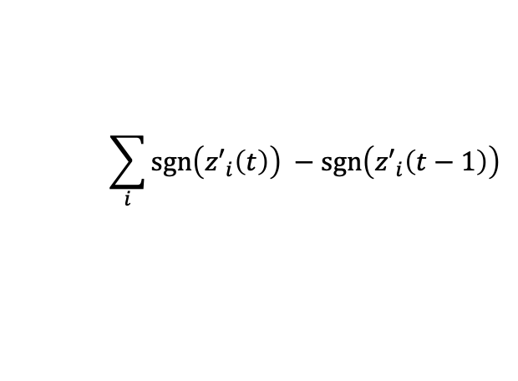
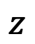
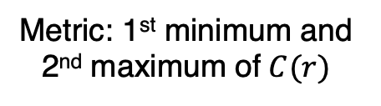
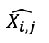
Dimensionality reduction
Microstructure trajectories
Latent dimension trajectories
Metrics
Methods
Global reconstruction
Local reconstruction
Smoothness
Principal Component Analysis
$$\left\{z_{i}\left(t\right)\right\}$$
$$z$$
Autoencoders
$$X_{i,j}$$
$$\hat{X_{i,j}}$$
Metric:
Diffusion Maps
Metric: $\sqrt{\sum_{i}{\sum_{j}{{\left(X_{i,j} −\hat{X_{i,j}}\right)}^{2}}}}$
Metric: 1st minimum and 2nd maximum of $C(r)$
$$\sum_{i}{\operatorname{sgn}\left({z′}_{i}\left(t\right)\right) −\operatorname{sgn}\left({z′}_{i}\left(t−1\right)\right)}$$
$$\cos^{−1}\left(\overline{z′\left(t\right)} .\overline{z′\left(t−1\right)}\right)$$
Notes:
Wanted to start by asking the question <TITLE>
Broad approach: Identify property of interest, identify which microstructures would help achieve that, and work backwards to design processing conditions that can achieve that desired microstructure
Example: If we want to design smart window coatings that (heat cool), we are looking for a material with temp dependent IR properties. One such material is Vox, which shows a temp-induced MIT that not only alters its conductivity but also its IR properties. Our efforts would then go into designing Vox films with MITs that makes them usable at a desired temp range, say by optimizing film thickness, composition etc.
Example: If we want to design solar cells high energy conversion efficiencies: looking for materials with bandgap properties which depends on material composition. Optimizing composition, we have found that GaAs and perovskite thin film solar cells allow conversion efficiencies much higher than Si based cells
Example: gears with high surface roughness, XXXX
The common thread across these applications is that <BOX> | <Composition, crystal structure, higher level microstructure

Slide 6
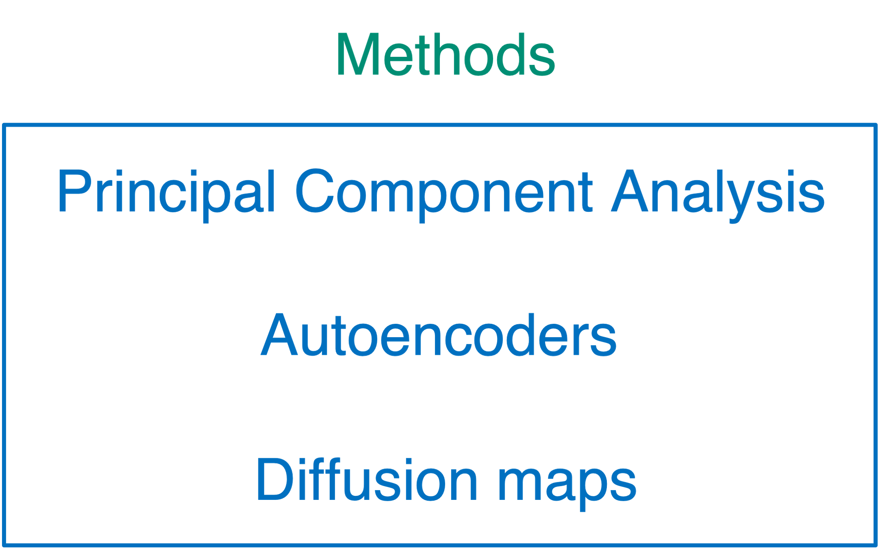
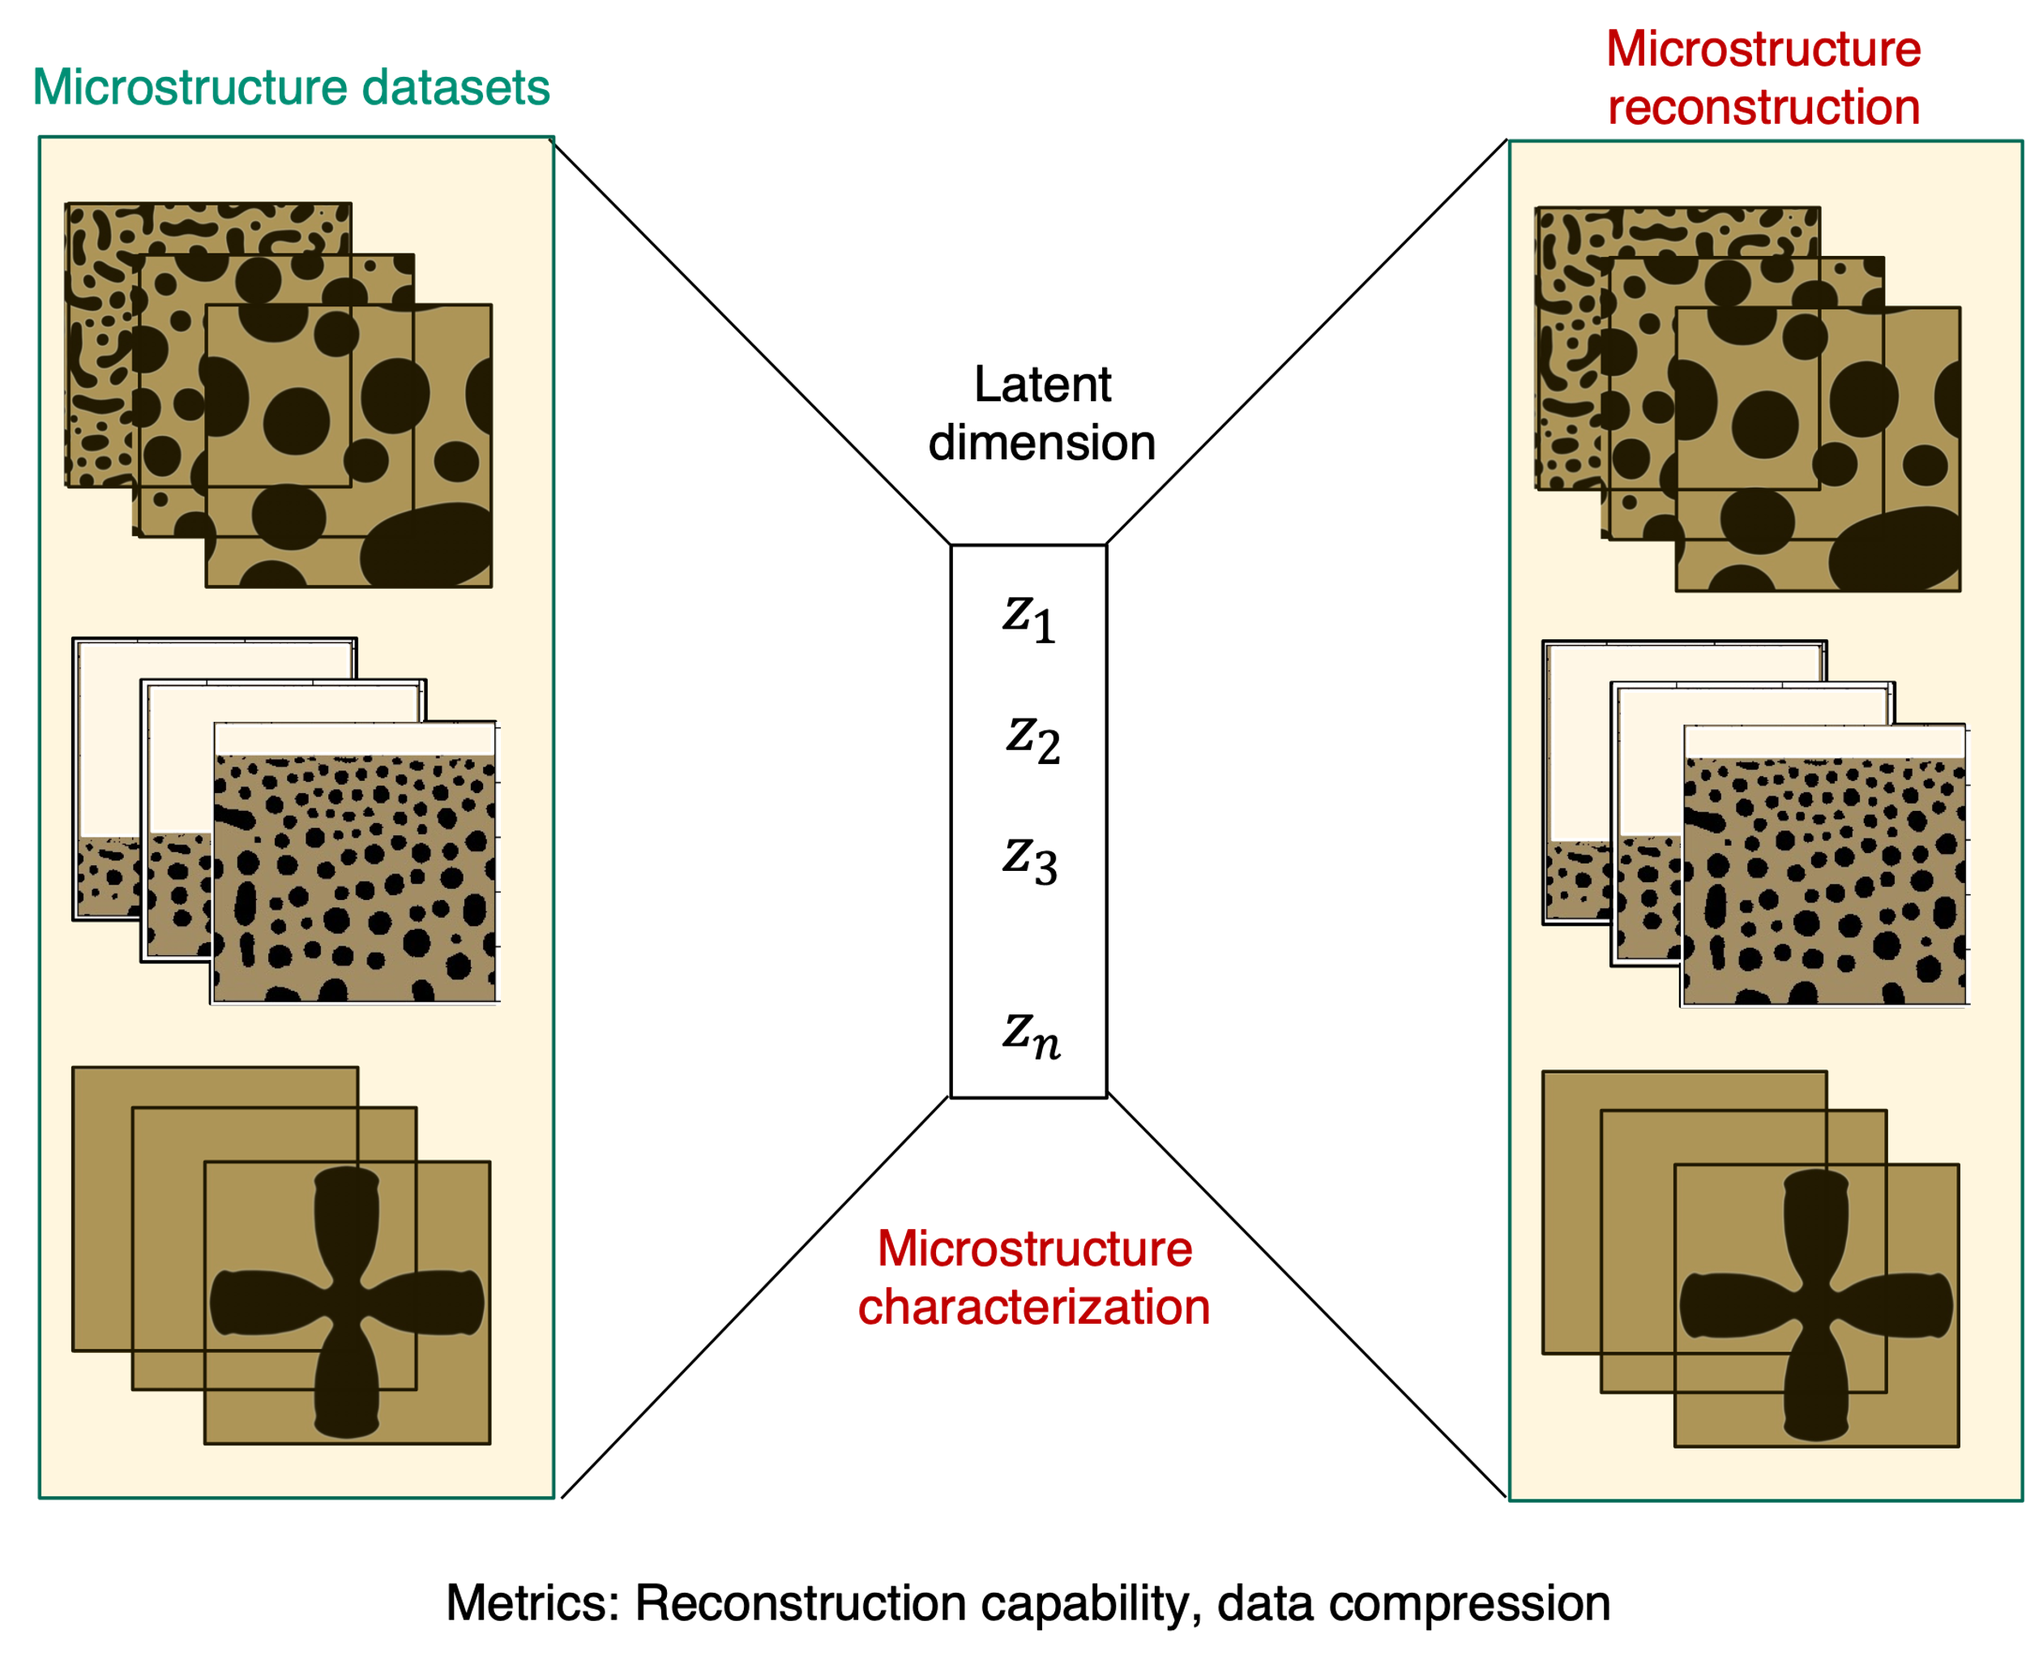
Notes:
Wanted to start by asking the question <TITLE>
Broad approach: Identify property of interest, identify which microstructures would help achieve that, and work backwards to design processing conditions that can achieve that desired microstructure
Example: If we want to design smart window coatings that (heat cool), we are looking for a material with temp dependent IR properties. One such material is Vox, which shows a temp-induced MIT that not only alters its conductivity but also its IR properties. Our efforts would then go into designing Vox films with MITs that makes them usable at a desired temp range, say by optimizing film thickness, composition etc.
Example: If we want to design solar cells high energy conversion efficiencies: looking for materials with bandgap properties which depends on material composition. Optimizing composition, we have found that GaAs and perovskite thin film solar cells allow conversion efficiencies much higher than Si based cells
Example: gears with high surface roughness, XXXX
The common thread across these applications is that <BOX> | <Composition, crystal structure, higher level microstructure

Slide 7


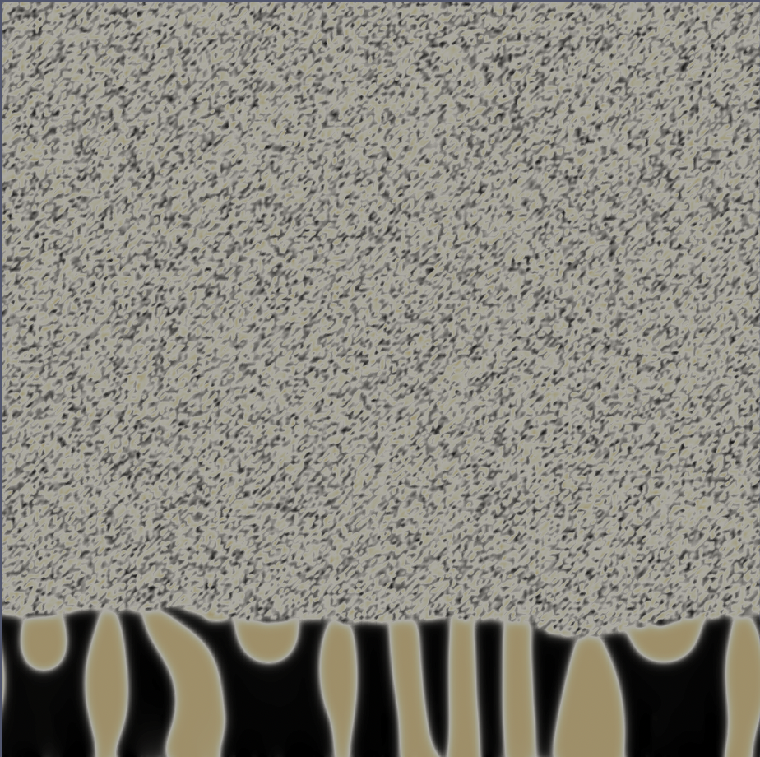
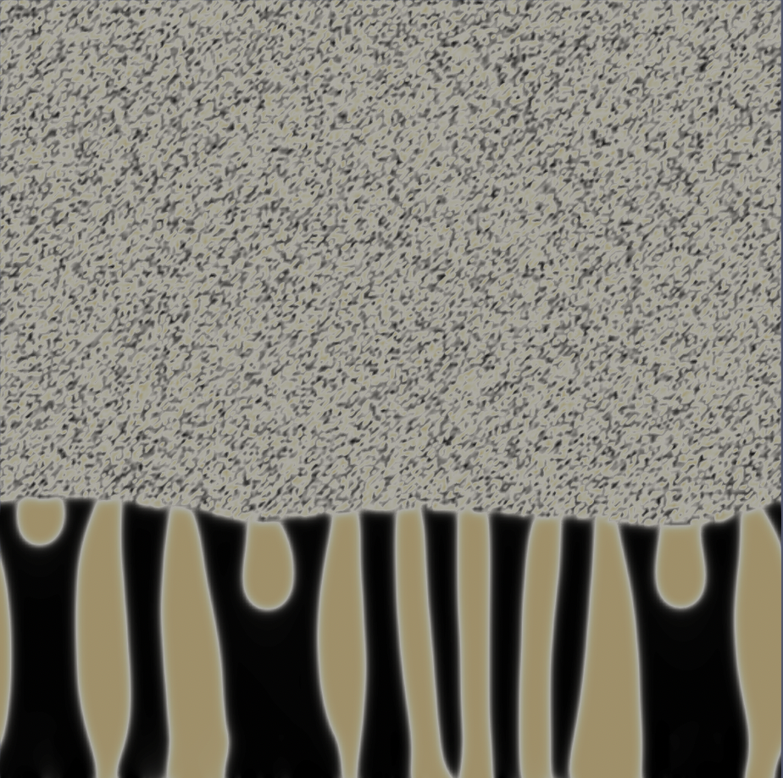
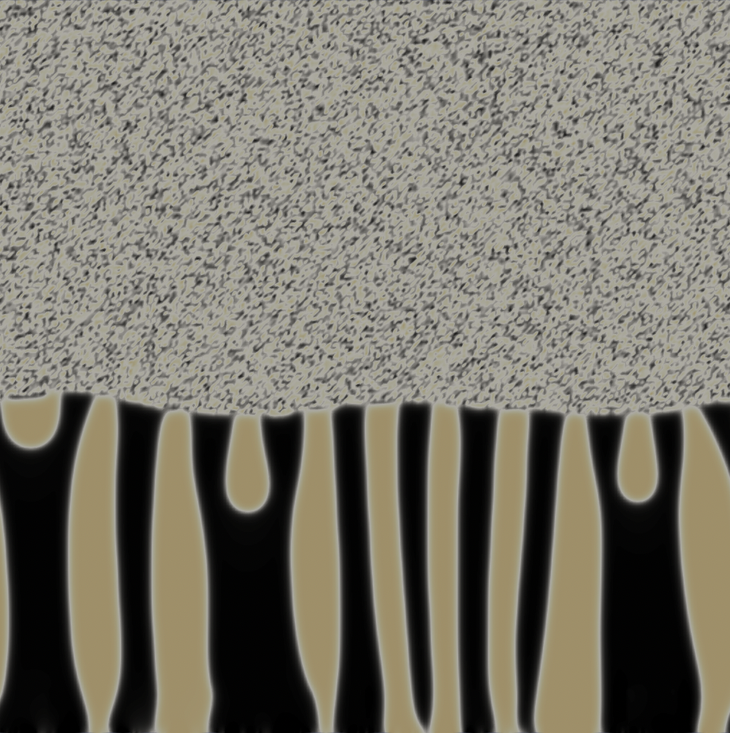

Time evolution
(a)
(b)
(c)
Notes:
Wanted to start by asking the question <TITLE>
Broad approach: Identify property of interest, identify which microstructures would help achieve that, and work backwards to design processing conditions that can achieve that desired microstructure
Example: If we want to design smart window coatings that (heat cool), we are looking for a material with temp dependent IR properties. One such material is Vox, which shows a temp-induced MIT that not only alters its conductivity but also its IR properties. Our efforts would then go into designing Vox films with MITs that makes them usable at a desired temp range, say by optimizing film thickness, composition etc.
Example: If we want to design solar cells high energy conversion efficiencies: looking for materials with bandgap properties which depends on material composition. Optimizing composition, we have found that GaAs and perovskite thin film solar cells allow conversion efficiencies much higher than Si based cells
Example: gears with high surface roughness, XXXX
The common thread across these applications is that <BOX> | <Composition, crystal structure, higher level microstructure

Slide 8
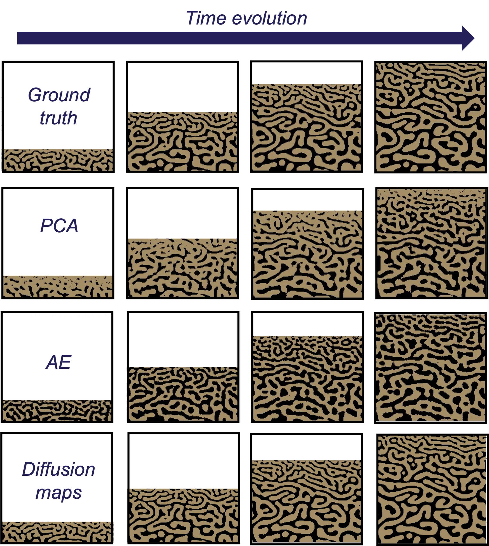
Notes:
Wanted to start by asking the question <TITLE>
Broad approach: Identify property of interest, identify which microstructures would help achieve that, and work backwards to design processing conditions that can achieve that desired microstructure
Example: If we want to design smart window coatings that (heat cool), we are looking for a material with temp dependent IR properties. One such material is Vox, which shows a temp-induced MIT that not only alters its conductivity but also its IR properties. Our efforts would then go into designing Vox films with MITs that makes them usable at a desired temp range, say by optimizing film thickness, composition etc.
Example: If we want to design solar cells high energy conversion efficiencies: looking for materials with bandgap properties which depends on material composition. Optimizing composition, we have found that GaAs and perovskite thin film solar cells allow conversion efficiencies much higher than Si based cells
Example: gears with high surface roughness, XXXX
The common thread across these applications is that <BOX> | <Composition, crystal structure, higher level microstructure

Slide 9
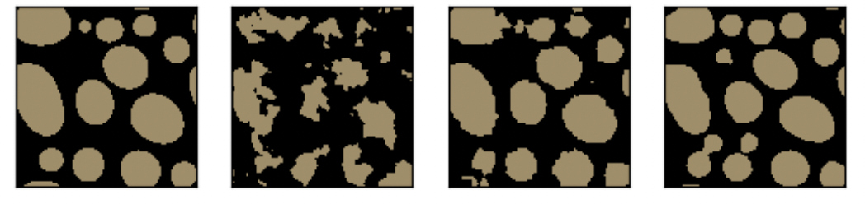
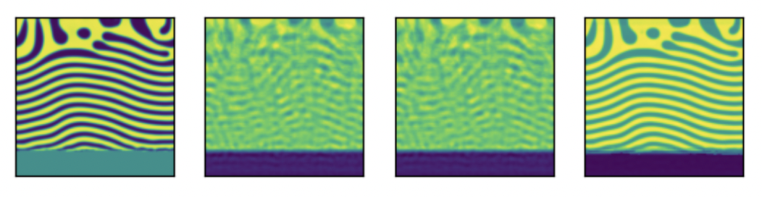

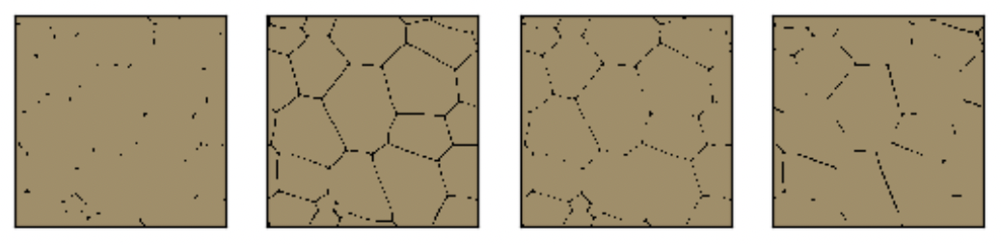
Ground truth
PCA
Autoencoder
Diffusion maps
(a)
(b)
(c)
(d)
Notes:
Wanted to start by asking the question <TITLE>
Broad approach: Identify property of interest, identify which microstructures would help achieve that, and work backwards to design processing conditions that can achieve that desired microstructure
Example: If we want to design smart window coatings that (heat cool), we are looking for a material with temp dependent IR properties. One such material is Vox, which shows a temp-induced MIT that not only alters its conductivity but also its IR properties. Our efforts would then go into designing Vox films with MITs that makes them usable at a desired temp range, say by optimizing film thickness, composition etc.
Example: If we want to design solar cells high energy conversion efficiencies: looking for materials with bandgap properties which depends on material composition. Optimizing composition, we have found that GaAs and perovskite thin film solar cells allow conversion efficiencies much higher than Si based cells
Example: gears with high surface roughness, XXXX
The common thread across these applications is that <BOX> | <Composition, crystal structure, higher level microstructure

Slide 10
Ground truth
PCA
Autoencoder
Diffusion maps
(a)
(b)
(c)
(d)
Notes:
Wanted to start by asking the question <TITLE>
Broad approach: Identify property of interest, identify which microstructures would help achieve that, and work backwards to design processing conditions that can achieve that desired microstructure
Example: If we want to design smart window coatings that (heat cool), we are looking for a material with temp dependent IR properties. One such material is Vox, which shows a temp-induced MIT that not only alters its conductivity but also its IR properties. Our efforts would then go into designing Vox films with MITs that makes them usable at a desired temp range, say by optimizing film thickness, composition etc.
Example: If we want to design solar cells high energy conversion efficiencies: looking for materials with bandgap properties which depends on material composition. Optimizing composition, we have found that GaAs and perovskite thin film solar cells allow conversion efficiencies much higher than Si based cells
Example: gears with high surface roughness, XXXX
The common thread across these applications is that <BOX> | <Composition, crystal structure, higher level microstructure

Slide 11
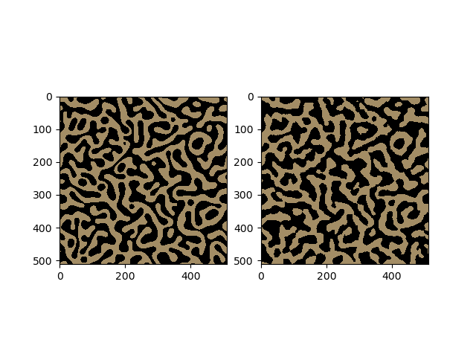
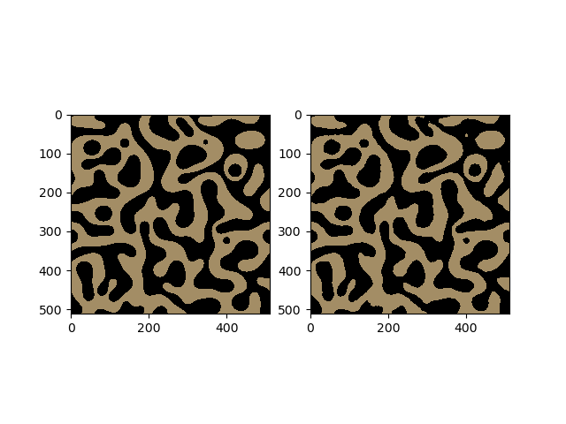
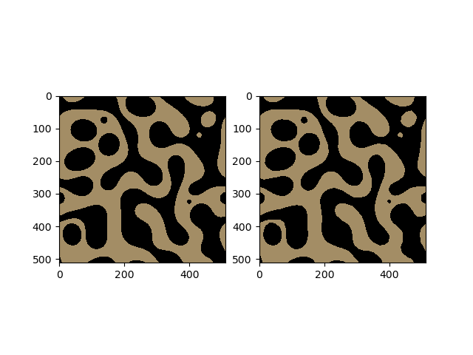
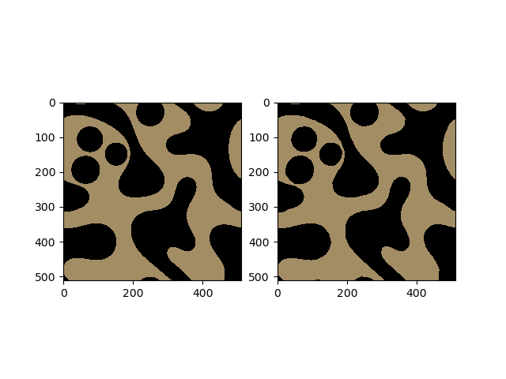
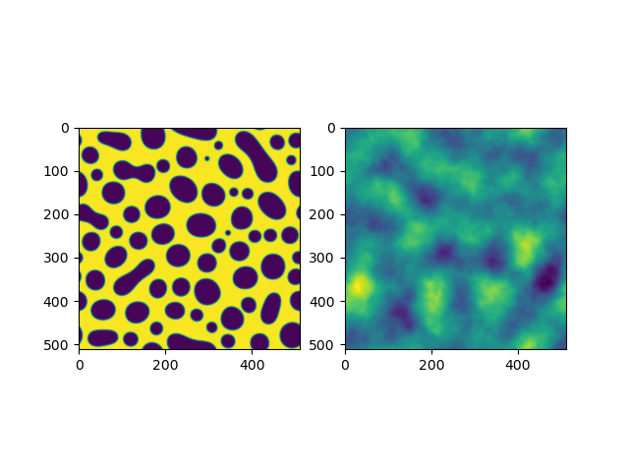
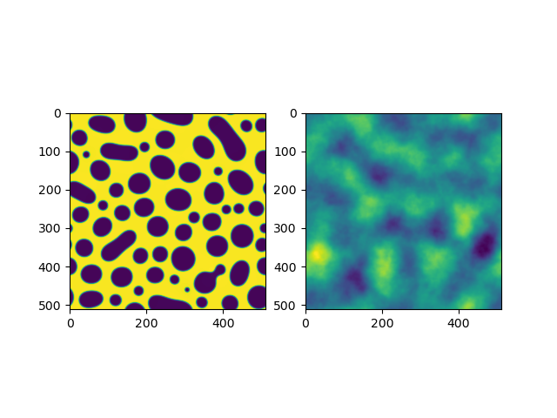
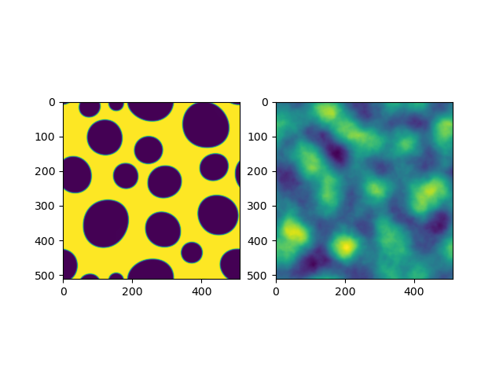
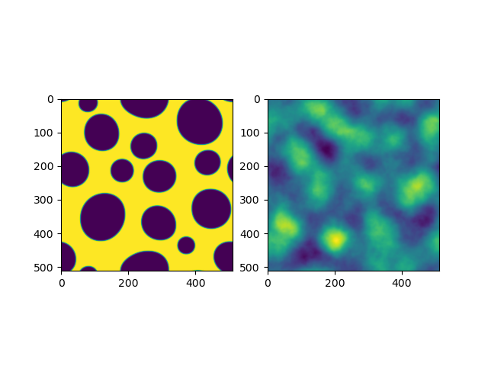
Time evolution
Ground truth
PCA reconstruction
Autoencoder reconstruction
Diffusion map reconstruction
Notes:
Wanted to start by asking the question <TITLE>
Broad approach: Identify property of interest, identify which microstructures would help achieve that, and work backwards to design processing conditions that can achieve that desired microstructure
Example: If we want to design smart window coatings that (heat cool), we are looking for a material with temp dependent IR properties. One such material is Vox, which shows a temp-induced MIT that not only alters its conductivity but also its IR properties. Our efforts would then go into designing Vox films with MITs that makes them usable at a desired temp range, say by optimizing film thickness, composition etc.
Example: If we want to design solar cells high energy conversion efficiencies: looking for materials with bandgap properties which depends on material composition. Optimizing composition, we have found that GaAs and perovskite thin film solar cells allow conversion efficiencies much higher than Si based cells
Example: gears with high surface roughness, XXXX
The common thread across these applications is that <BOX> | <Composition, crystal structure, higher level microstructure

Slide 12
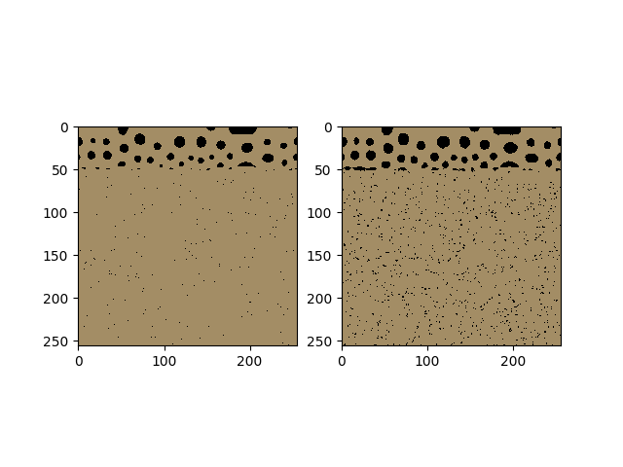
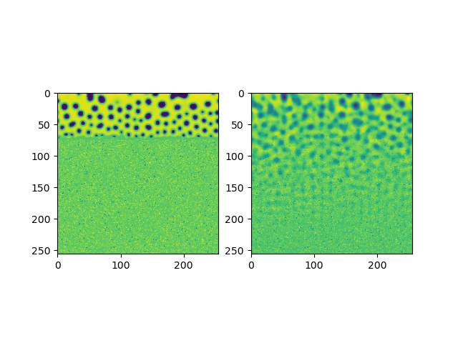
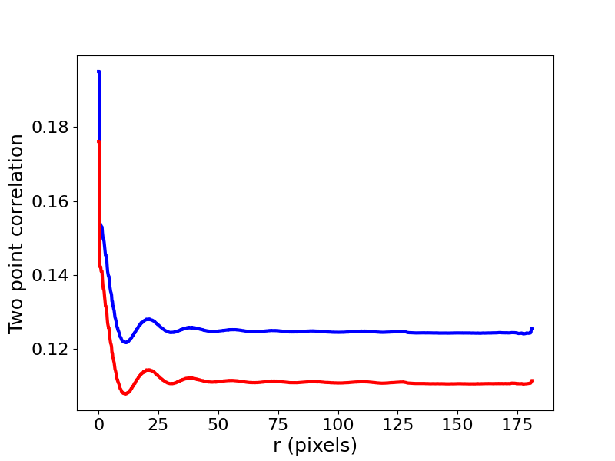
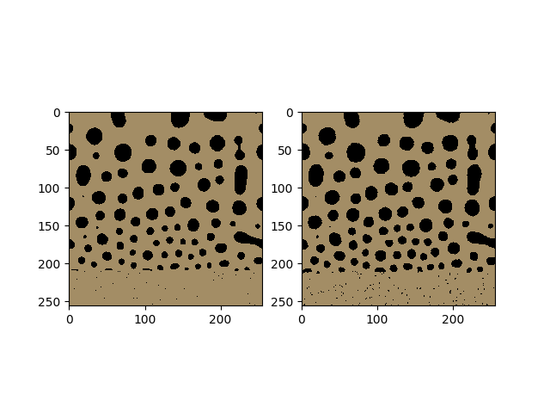
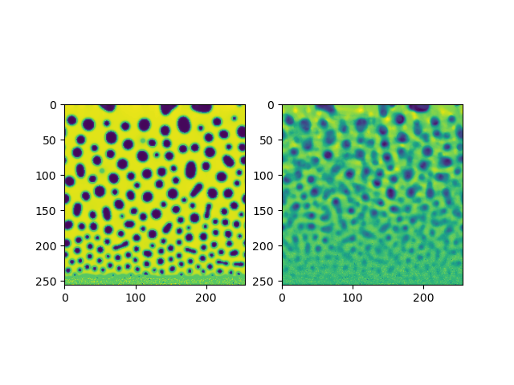
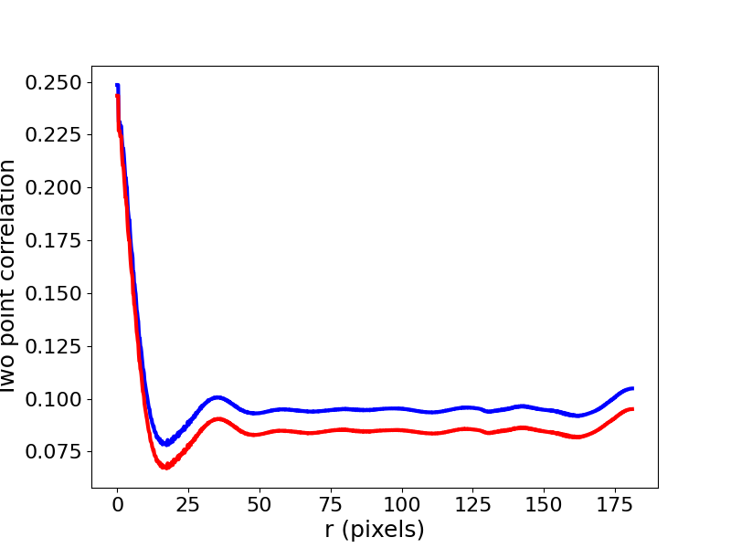
PCA reconstruction
Autoencoder reconstruction
Radial average of autocorrelation
Ground truth
t₀
GT
AE
t_{N}
GT
AE
Notes:
Wanted to start by asking the question <TITLE>
Broad approach: Identify property of interest, identify which microstructures would help achieve that, and work backwards to design processing conditions that can achieve that desired microstructure
Example: If we want to design smart window coatings that (heat cool), we are looking for a material with temp dependent IR properties. One such material is Vox, which shows a temp-induced MIT that not only alters its conductivity but also its IR properties. Our efforts would then go into designing Vox films with MITs that makes them usable at a desired temp range, say by optimizing film thickness, composition etc.
Example: If we want to design solar cells high energy conversion efficiencies: looking for materials with bandgap properties which depends on material composition. Optimizing composition, we have found that GaAs and perovskite thin film solar cells allow conversion efficiencies much higher than Si based cells
Example: gears with high surface roughness, XXXX
The common thread across these applications is that <BOX> | <Composition, crystal structure, higher level microstructure

Slide 13
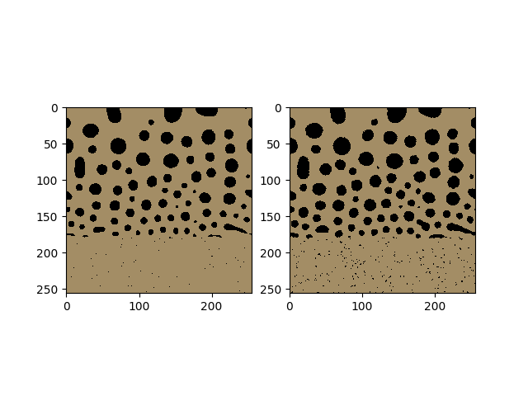
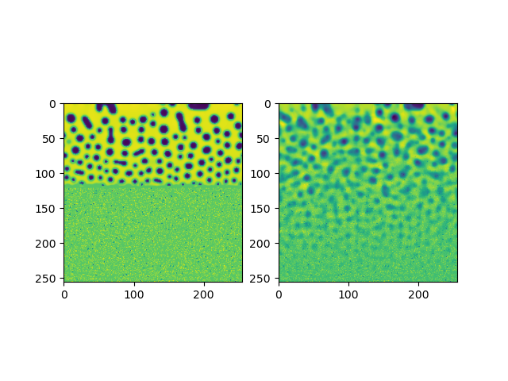

Time evolution
Ground truth
PCA reconstruction
Autoencoder reconstruction
Diffusion map reconstruction
Notes:
Wanted to start by asking the question <TITLE>
Broad approach: Identify property of interest, identify which microstructures would help achieve that, and work backwards to design processing conditions that can achieve that desired microstructure
Example: If we want to design smart window coatings that (heat cool), we are looking for a material with temp dependent IR properties. One such material is Vox, which shows a temp-induced MIT that not only alters its conductivity but also its IR properties. Our efforts would then go into designing Vox films with MITs that makes them usable at a desired temp range, say by optimizing film thickness, composition etc.
Example: If we want to design solar cells high energy conversion efficiencies: looking for materials with bandgap properties which depends on material composition. Optimizing composition, we have found that GaAs and perovskite thin film solar cells allow conversion efficiencies much higher than Si based cells
Example: gears with high surface roughness, XXXX
The common thread across these applications is that <BOX> | <Composition, crystal structure, higher level microstructure

Slide 14








Time evolution
Ground truth
PCA reconstruction
Autoencoder reconstruction
Diffusion map reconstruction
Notes:
Wanted to start by asking the question <TITLE>
Broad approach: Identify property of interest, identify which microstructures would help achieve that, and work backwards to design processing conditions that can achieve that desired microstructure
Example: If we want to design smart window coatings that (heat cool), we are looking for a material with temp dependent IR properties. One such material is Vox, which shows a temp-induced MIT that not only alters its conductivity but also its IR properties. Our efforts would then go into designing Vox films with MITs that makes them usable at a desired temp range, say by optimizing film thickness, composition etc.
Example: If we want to design solar cells high energy conversion efficiencies: looking for materials with bandgap properties which depends on material composition. Optimizing composition, we have found that GaAs and perovskite thin film solar cells allow conversion efficiencies much higher than Si based cells
Example: gears with high surface roughness, XXXX
The common thread across these applications is that <BOX> | <Composition, crystal structure, higher level microstructure

Slide 15

(a)
(b)
Z = 3
PVD – autoencoder
Z = 10
Z = 7
PVD – PCA
Optimal reconstruction error
Dendrite – PCA
Dendrite – autoencoder
Spinodal decomposition
PVD
Dendrite evolution
Grain growth
Notes:
Wanted to start by asking the question <TITLE>
Broad approach: Identify property of interest, identify which microstructures would help achieve that, and work backwards to design processing conditions that can achieve that desired microstructure
Example: If we want to design smart window coatings that (heat cool), we are looking for a material with temp dependent IR properties. One such material is Vox, which shows a temp-induced MIT that not only alters its conductivity but also its IR properties. Our efforts would then go into designing Vox films with MITs that makes them usable at a desired temp range, say by optimizing film thickness, composition etc.
Example: If we want to design solar cells high energy conversion efficiencies: looking for materials with bandgap properties which depends on material composition. Optimizing composition, we have found that GaAs and perovskite thin film solar cells allow conversion efficiencies much higher than Si based cells
Example: gears with high surface roughness, XXXX
The common thread across these applications is that <BOX> | <Composition, crystal structure, higher level microstructure

Slide 16



(a)
(b)
(c)
Autoencoder
Notes:
Wanted to start by asking the question <TITLE>
Broad approach: Identify property of interest, identify which microstructures would help achieve that, and work backwards to design processing conditions that can achieve that desired microstructure
Example: If we want to design smart window coatings that (heat cool), we are looking for a material with temp dependent IR properties. One such material is Vox, which shows a temp-induced MIT that not only alters its conductivity but also its IR properties. Our efforts would then go into designing Vox films with MITs that makes them usable at a desired temp range, say by optimizing film thickness, composition etc.
Example: If we want to design solar cells high energy conversion efficiencies: looking for materials with bandgap properties which depends on material composition. Optimizing composition, we have found that GaAs and perovskite thin film solar cells allow conversion efficiencies much higher than Si based cells
Example: gears with high surface roughness, XXXX
The common thread across these applications is that <BOX> | <Composition, crystal structure, higher level microstructure

